Slide 1
Bilingualism as a catalyst for sound change: Individual differences in f0 cue usage in the Kuy register contrast
Raksit Lau-Preechathammarach
University of California, Berkeley
raksit@berkeley.edu
96th Annual Meeting of the Linguistics Society of America
January 7, 2022

Slide 2


Acknowledgments
I am honored to be learning from the Kuy people of Bâan Khîi Nâak, learning on the traditional, ancestral, and unceded lands of the Ohlone people, and presenting on the traditional, ancestral, and unceded lands of the Nacotchtank and Piscataway peoples.
สิดาวรรณ ไชยภา ทองวิไลย์ อินตะนัย
Sidawun Chaiyapha Thongwilai Intanai

Slide 3
Language contact, bilingualism, & change
Macro-Level: Convergence of areal features
Bilingualism in language contact can lead to structural change (Thomason 2001)
Spread of tonogenesis in Mainland Southeast Asia suggested to involve extensive bilingualism (Matisoff 2001)
Micro-Level: Cues and Contrast
Bilingual & monolingual cue usage differ (Llanos et al. 2013, Schertz et al. 2015)
Drift of L1 categories even when input ambient (Chang 2019)

Slide 4
Cue weighting and pitch
Register contrast relatively common in Mainland Southeast Asia
Tonogenesis: f0 becomes primary cue in contrast (Kang 2014, Coetzee et al. 2018)
Cross-pollination of cue usage across languages in same speaker (Llanos et al. 2013, Schertz et al. 2015)
Questions for this study
To what extent does bilingualism play a role in sound change?
Does language usage/ability affect extent of cross-pollination?
Register | Voice quality | f0 | F1
high | modal | higher | higher
low | breathy | lower | lower

Slide 5
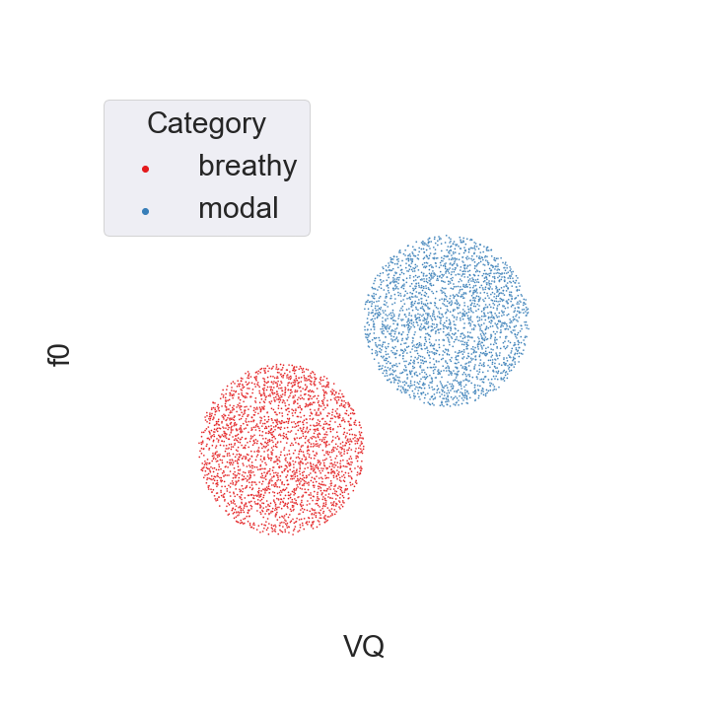
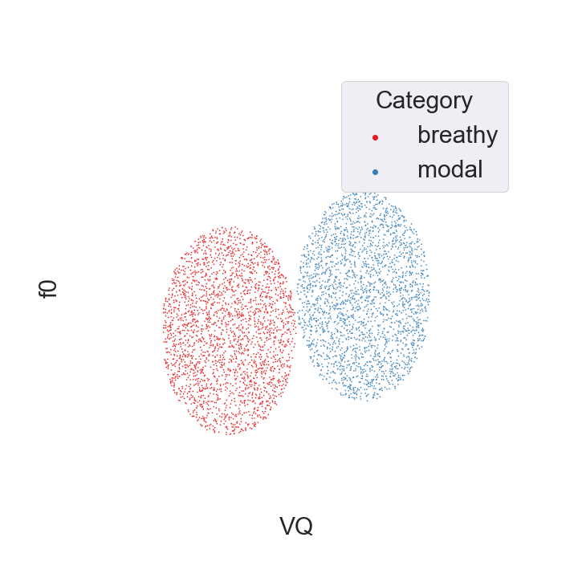
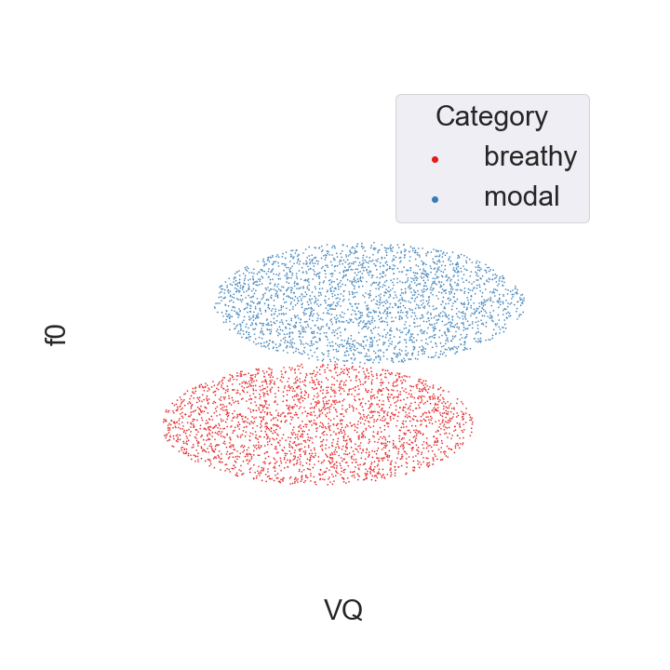
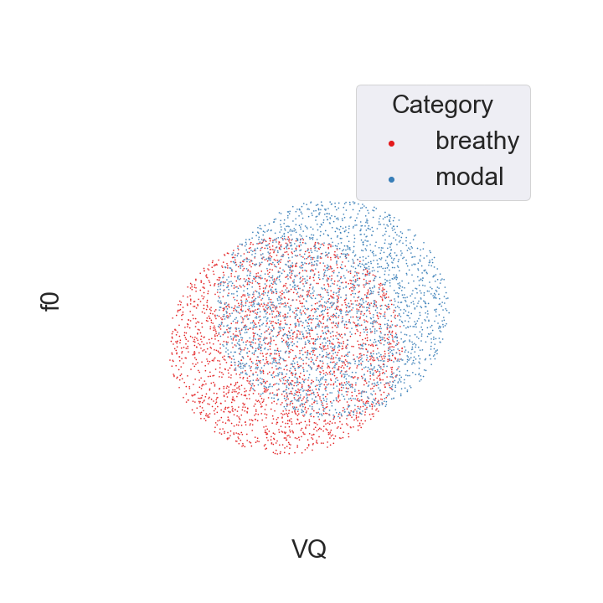
Cue weighting & tone (based on Maran 1973)
Stage 2a: f0 enhancement
Stage 1: VQ contrast
Stage 3: f0 contrast
Stage 2b: VQ weakening

Slide 6
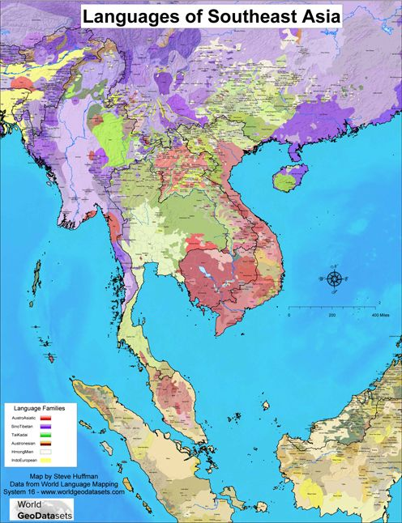
Kuy (Katuic, Austroasiatic) multilingualism
Pride in ability to speak 4 languages (Kuy, Thai, Lao, Khmer), but multilingualism decreasing
For at least 20 years, preference for Thai has grown (Sukgasame 2003)
Present day in Bâan Khîi Nâak: children mainly acquiring Thai
Age | Quadrilingual | Tri- | Bi- | Total
>45 | 55 | 4 | 0 | 59
≤45 | 38 | 16 | 4 | 58

Slide 7
Recent social changes
Centralization of Thailand starting from Siamese Revolution of 1932: promotion of Central Thai, rural schools
Recent globalization: improved transportation, more schooling
Most >45 attended school (est. 1939) up to 4th grade
5th and 6th grade added in 1972, 7th – 9th grades in 1998
Most younger people finish high school and attend college
Age | Lived elsewhere | Never lived elsewhere
>45 | 26 | 33
≤45 | 51 | 7

Slide 8

Kuy register contrast
taʔ ‘to grab’ vs. ta͈ʔ ‘place under’
Contact languages: Thai and Lao are tonal, Khmer is not
Considerable variation in multilingual usage and ability of different members of the Kuy community
Hypotheses
Kuy speakers who use more Thai/Lao will, compared to their peers, in the register contrast
Have larger f0 differences in production
Be more influenced by f0 in perception

Slide 9

Production experiment design
66 participants balanced for age and gender
58 unique words (31 targets, 27 distractors), minimally differing by register (modal vs. breathy)
Carrier sentence: “I say the word X for them to hear”
Gender | 20s | 30s | 50s | 60s
F | 8 | 8 | 10 | 8
M | 8 | 8 | 7 | 9
haj waw pna:j paj n᷂trɛ͈:l ɑ:n naw cŋat

Slide 10

Production experiment presentation
Thai sentences presented in random order with images to aid in translation
Prevent reading pronunciation
Kuy orthography not standard
Practice, then 5 trial rounds
Follow-up sociolinguistic questionnaire based on Birdsong et al. (2012)

Slide 11
Perception stimuli design
Adapted Pratt script w/ KlaatGrid synthesizer (Brunelle et al. 2021)
Acoustic parameters enhanced from average trajectories of speakers with clear distinction, based on production
Intermediate F1 value between registers for all stimuli
5 starting f0 x 5 starting OQ (open quotient) values
Stimuli piloted and revised for naturalness
/ti:/ ‘old’ | /ti͈:/ ‘tall’
/taʔ/ ‘to grab’ | /ta͈ʔ/ ‘to place under’

Slide 12
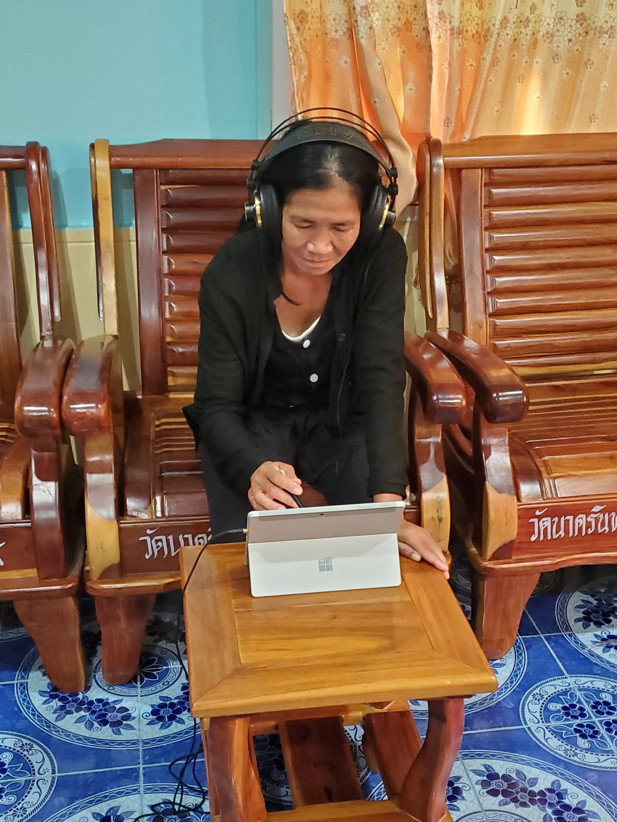
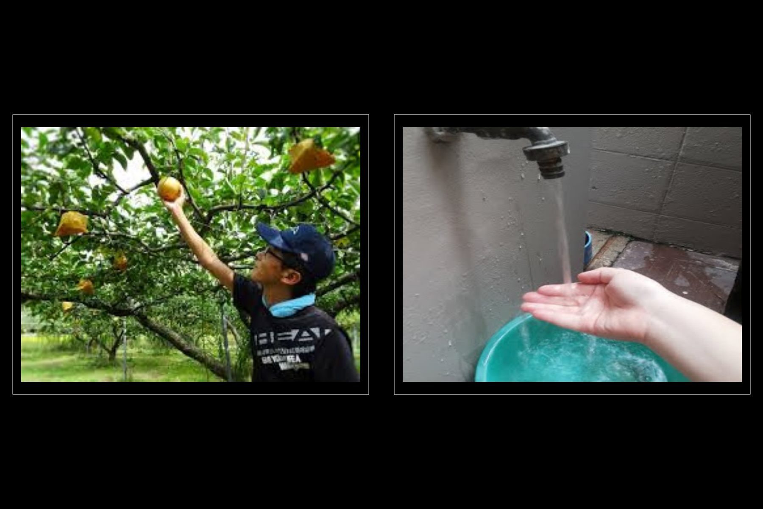
Perception experiment presentation
2AFC: participants chose which word they heard
64 participants perfectly balanced for age and gender
Followed by sociolinguistic questionnaire & interview

Slide 13

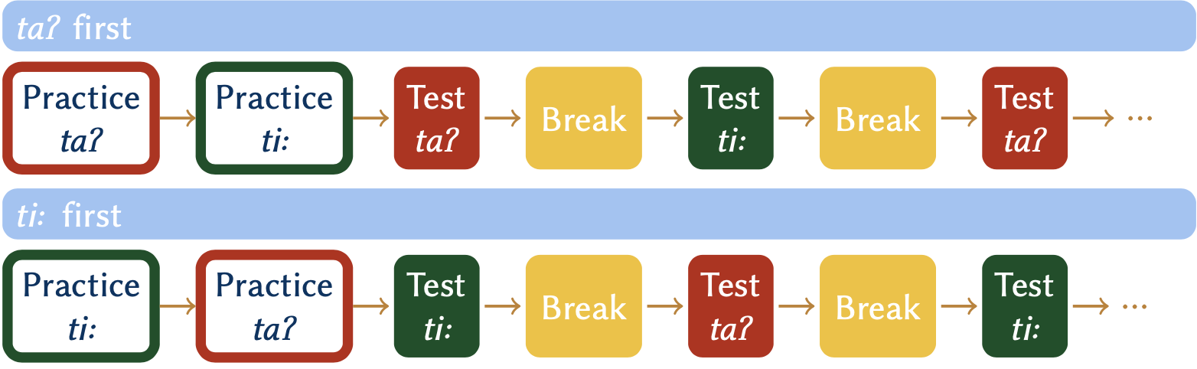
Perception experiment layout
Practice round for familiarization
8 alternating blocks of each syllable, optional breaks in between
5 f0 x 5 OQ = 25 tokens / block = 400 total
Half saw taʔ pair first, half ti: first

Slide 14
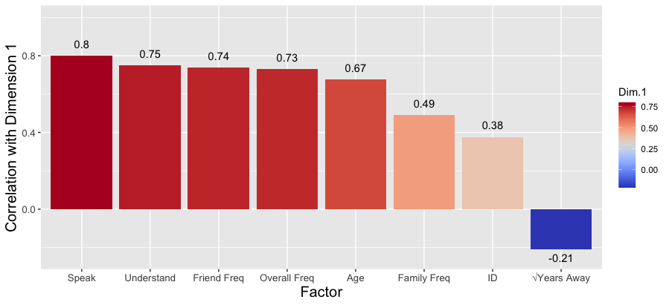
Principal components analysis
PCA: find dimensions that capture variation of data
FactoMineR package in R (Lê et al. 2008)
Dimension 1 (39.51%): “Tonal language experience” (TLE)

Slide 15
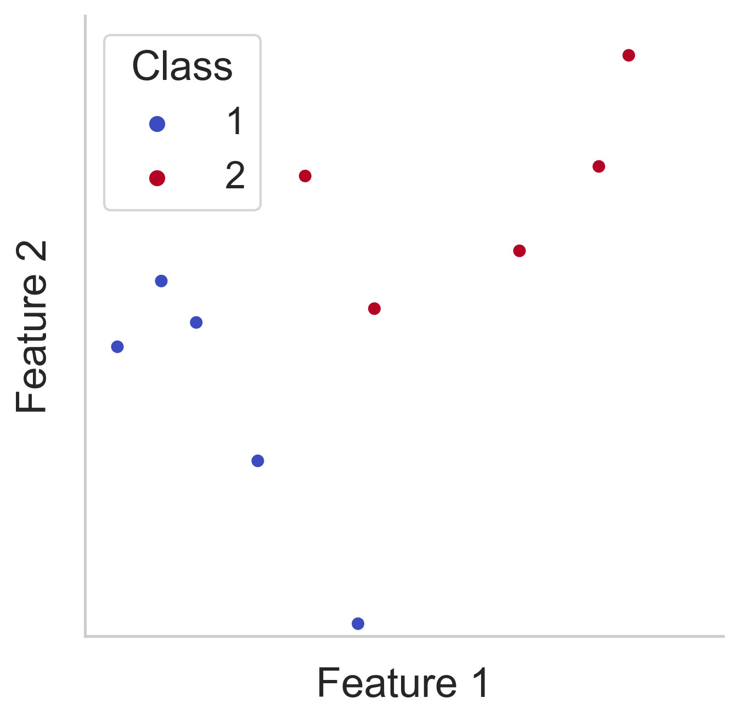
Linear discriminant analysis (LDA)
Train algorithm to find line that best separates classes, given features, then run classifier on test set
Results compared to data and accuracy score calculated
Used scikit-learn python package (Van Rossum & Drake 2009)

Slide 16
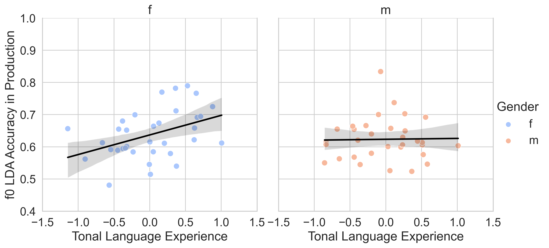
Production individual differences (n = 66)
Correlation of LDA f0 accuracy in production with TLE
r = .42, p < .05 * r = .02, p = .91
Female speakers with more TLE have larger f0 differences between registers

Slide 17
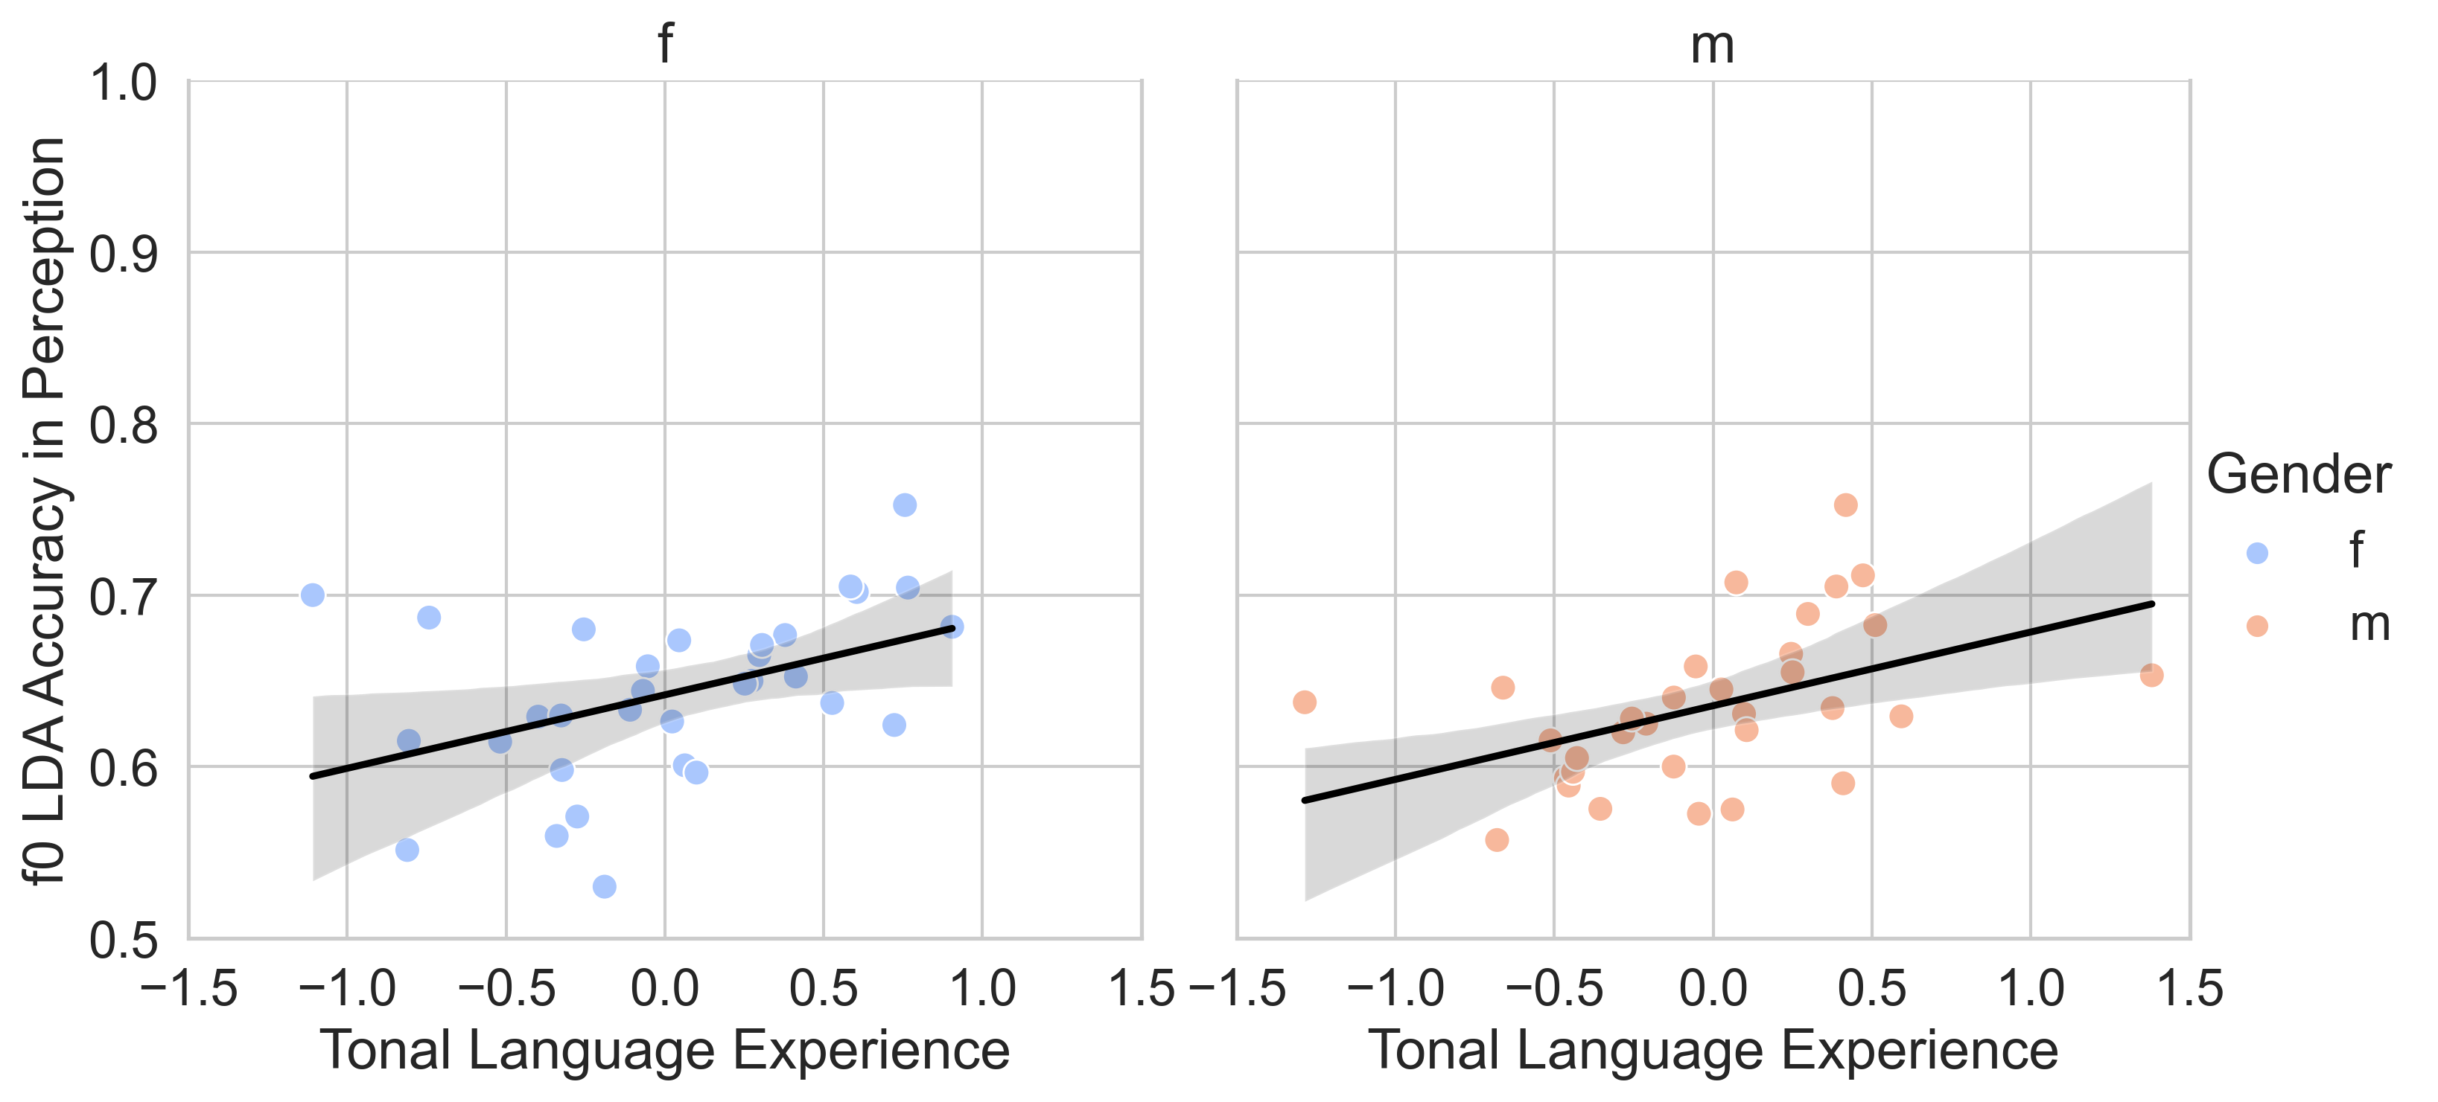
Perception individual differences (n = 64)
Correlation of LDA f0 accuracy in perception with TLE
r = .44, p < .05 * r = .46, p < .01 **
Speakers with more TLE weigh f0 more heavily in perceiving register contrast

Slide 18
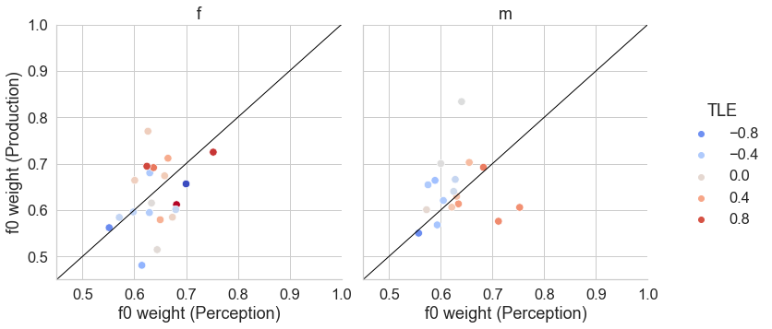
Perception-production link
37 speakers overlapped between both studies
No evidence of perception or production being “ahead”
Speakers with more TLE (redder) appear to weigh f0 more heavily for both perception and production overall

Slide 19
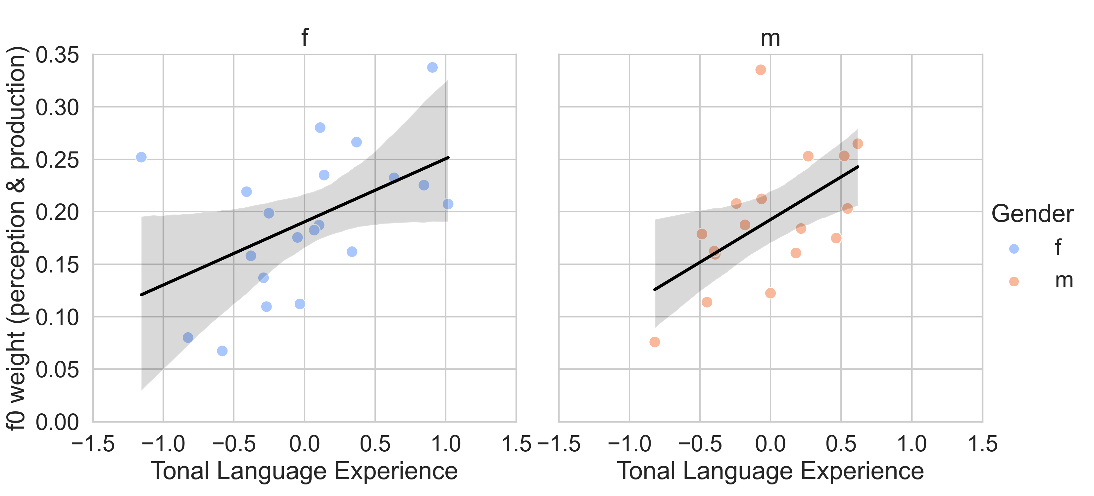
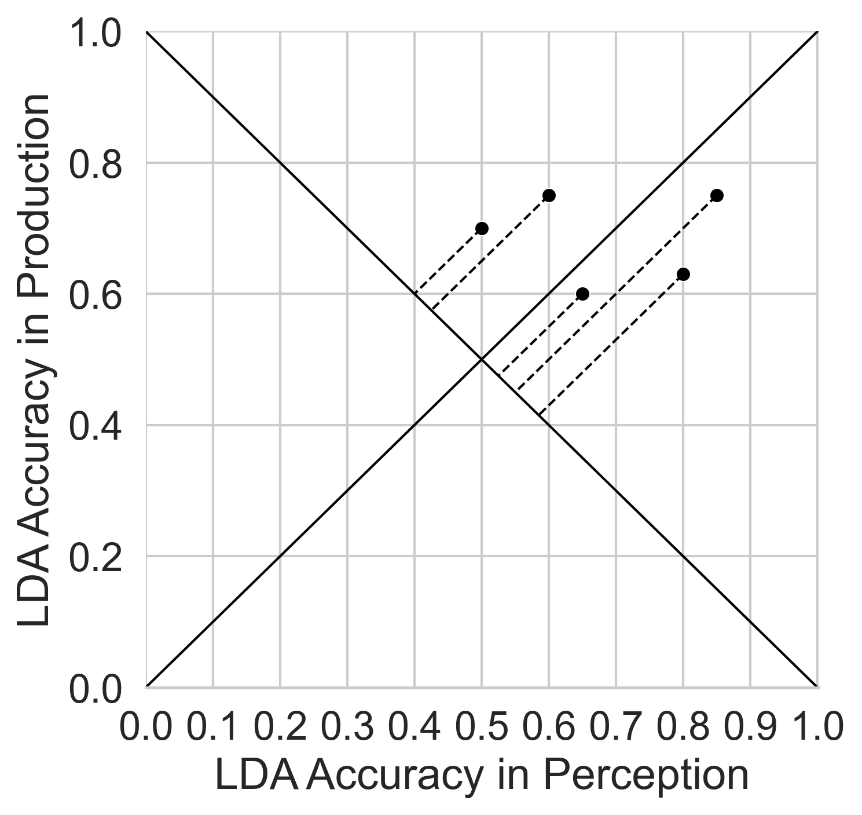
Perception & production cue weighting
Calculate how “northeast” each point is as measure of how important f0 cue is in perception and production
r = .5, p < .05 * r = .55, p < .02 *
Speakers with more TLE weigh f0 more heavily for both perception and production overall

Slide 20
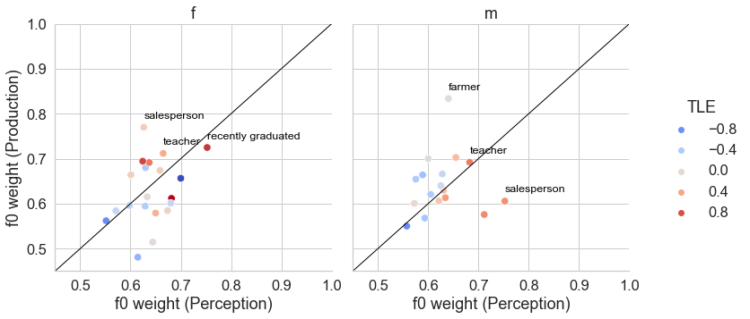
Sociolinguistic factors
Occupations of 3 F & 3 M speakers with highest distance
Except for “farmer”, occupations involve greater usage of lingua francas (either Thai or Lao)

Slide 21
Conclusions
Evidence for f0 enhancement, particularly for female speakers
These speakers may push distribution towards tonogenesis
Stage 2a: f0 enhancement
Stage 1: VQ contrast

Slide 22
Conclusions
Kuy in contact with Thai, Lao, and Khmer for a long time
Transition from quadrilingualism to bilingualism in Thai
Shift in cue usage builds on preexisting conditions
Enhancement of existing f0 cues in register distinction
f0 cue usage in Thai/Lao transfers to heavier f0 cue weighting in Kuy, setting stage for potential tonogenesis
Support for bilingualism as catalyst in sound change

Slide 23
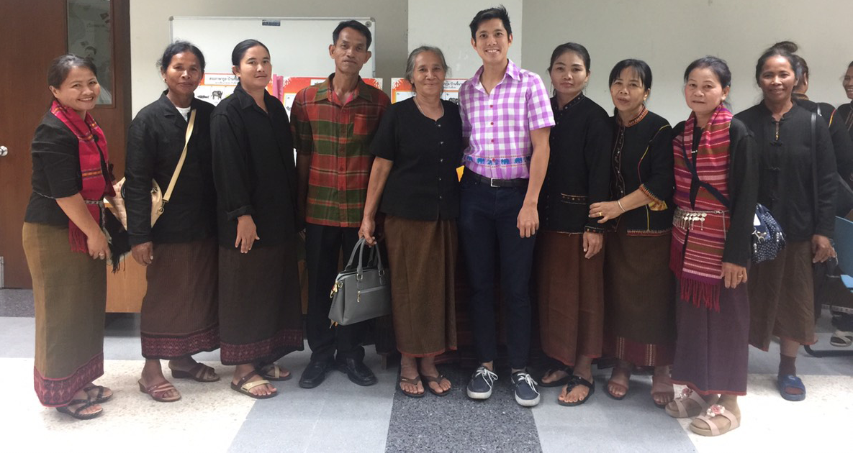
ขอบคุณ คร่บนะ [khɑ̀pkʰun krɔ͈pnaʔ] Thank you everyone!
Special thanks to everyone I worked with in Tambon Tum. Many thanks as well to Susan Lin, Andrew Garrett, Justin Davidson, Ron Sprouse, Pittayawat Pittayaporn, Suwilai Premsrirat, Marc Brunelle, James Kirby, Ryan Gehrmann, Sujinat Jitwiriyanont, Kumaree Laparporn, Atcharaporn Thawornpat, Emily Remirez, Julia Nee, Eric Wilbanks, Edwin Ko, Alice Shen, Meg Cychosz, Qingyang Wang, and Pisut Thongtan for help at various stages in this research and to the audiences of Phorum, LabPhon17, and ASA 179 for feedback on earlier versions of this work. I am also highly indebted to my mentees, Margaret Asperheim, Bethany Auclair, Renee Cong, Nicole Kim, Jenkin Leung, Melissa Milligan, Geetanshi Sharma, Melody Tran, Stacey Vu, Crystal Wang, Ivori White, and Cynthia Zhong for their tremendous hard work in annotating data for this project. Thanks to the Oswalt Endangered Languages Grant and Lewis and Clark Fund for Exploration and Field Research from the American Philosophical Society for funding.

Slide 24
References
Birdsong, David, Libby M. Gertken, and Mark Amengual. 2012. Bilingual language profile: An easy-to-use instrument to assess bilingualism. University of Texas at Austin: COERLL. https://sites.la.utexas.edu/bilingual (accessed 28 August 2020).
Brunelle, Marc, Thành Tấn Tạ, James Kirby, and Lư Giang Đinh. 2020. Transphonologization of voicing in Chru: Studies in production and perception. Laboratory Phonology: Journal of the Association for Laboratory Phonology 11:1–33. https://doi.org/10.5334/labphon.278.
Chang, Charles B. 2019. Language change and linguistic inquiry in a world of multicompetence: Sustained phonetic drift and its implications for behavioral linguistic research. Journal of Phonetics 74:96–113. https://doi.org/10.1016/j.wocn.2019.03.001.
Coetzee, Andries W., Patrice Speeter Beddor, Kerby Shedden, Will Styler, and Wissing Daan. 2018. Plosive voicing in Afrikaans: Differential cue weighting and tonogenesis. Journal of Phonetics 66:185–216. https://doi.org/10.1016/j.wocn.2017.09.009.
Kang, Yoonjung. 2014. Voice Onset Time merger and development of tonal contrast in Seoul Korean stops: A corpus study. Journal of Phonetics 45:76–90.
Llanos, Fernando, Olga Dmitrieva, Amanda Shultz, and Alexander L Francis. 2013. Auditory enhancement and second language experience in Spanish and English weighting of secondary voicing cues. The Journal of the Acoustical Society of America 134:2213–2224. https://doi.org/10.1121/1.4817845.

Slide 25
References
Lê, S., Josse, J. & Husson, F. (2008). FactoMineR: A package for multivariate analysis. Journal of Statistical Software, 25(1), 1–18. http://doi.org/10.18637/jss.v025.i01.
Maran, Laraw. 1973. On becoming a tone language: a Tibeto-Burman model of tonogenesis. In Consonant Types and Tone, Southern California Occasional Papers in Linguistics No. 1, ed. Larry M. Hyman, 98–114. Los Angeles: Linguistics Program, University of Southern California.
Matisoff, James A. 2001. Genetic versus contact relationship: prosodic diffusibility in South-East Asian languages. In Areal diffusion and genetic inheritance: problems in comparative linguistics, ed. Alexandra Y. Aikhenvald and R. M. W. Dixon, 291–327. Oxford: Oxford University Press.
Schertz, Jessamyn, Taehong Cho, Andrew Lotto, and Natasha Warner. 2015. Individual differences in phonetic cue use in production and perception of a non-native sound contrast. Journal of Phonetics 52:183–204. URL https://doi.org/10.1016/j.wocn.2015.07.003.
Sukgasame,Preecha. 2003. การแปรและการเปลี่ยนแปลงทางเสียงในภาษากวย-กูย(ส่วย) [Phonological variation and change in Kuai-Kui (Suai)]. PhD Dissertation, Chulalongkorn University. http://www.thaithesis.org/detail.php?id=1082547000388.
Thomason, Sarah G. 2001. Language contact. Edinburgh: Edinburgh University Press Ltd.
Van Rossum, G. & Drake, F. L. (2009). Python 3 reference manual. Scotts Valley, CA: CreateSpace. https://dl.acm.org/doi/book/10.5555/1593511.

